Slide 1
Computer vision for industrial inspection
NVIDIA DLI

Slide 2
Workshop Outline
Lab 1 | Automated Optical Inspection and Data Exploration Discuss automatic optical inspection, PCBA process, and current challenges of AOI machines on high false positives Perform EDA on real dataset from GPU production line Scope into short-term DL automation problem
Lab 2 | Model Training with Transfer Learning Apply transfer learning with ResNet-50 architecture Fine-tune the model and set up evaluation metrics Apply augmentation technique to solve heavily imbalanced dataset Examine a confusion matrix and fine-tune results based on domain-expert tunable thresholding
Lab 3 | Model Deployment for Inference Compile trained ResNet-50 model as TensorRT engine Deploy TRT engine to Triton Inference Server Experiment various inference configurations to optimize performance
Assessment

Slide 3
DL-Based Solution Development workflow
Rapid Prototyping for Production
Scoping
Data Management
Experimentation
Deployment
Model Development
Training
Inference
Train Set
Validation
Define the Problem
Gather Data
Data Curation
Model Evaluation
Deployment
Validation Set
Satisfied
Not Satisfied
Re-train
Monitoring
Data Drift Detected

Slide 4
AGENDA
Lab 1 - Automatic Optical Inspection and Data Exploration
Lab 2 – Model Training with Transfer Learning
Lab 3 – Model Deployment for Inference Compile trained ResNet-50 model as TensorRT engine Deploy TRT engine to Triton Inference Server Experiment various inference configurations to optimize performance
Assessment

Slide 5
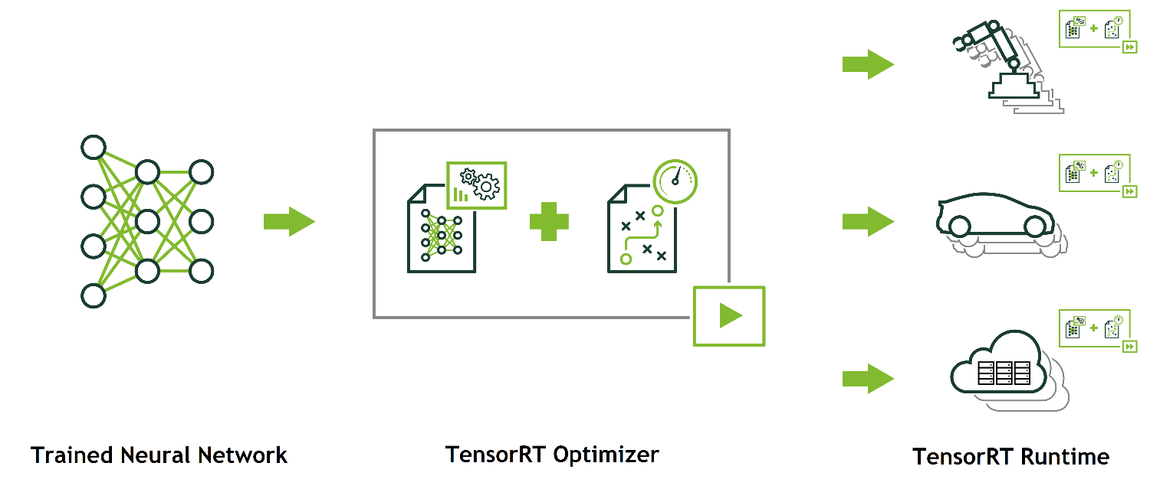


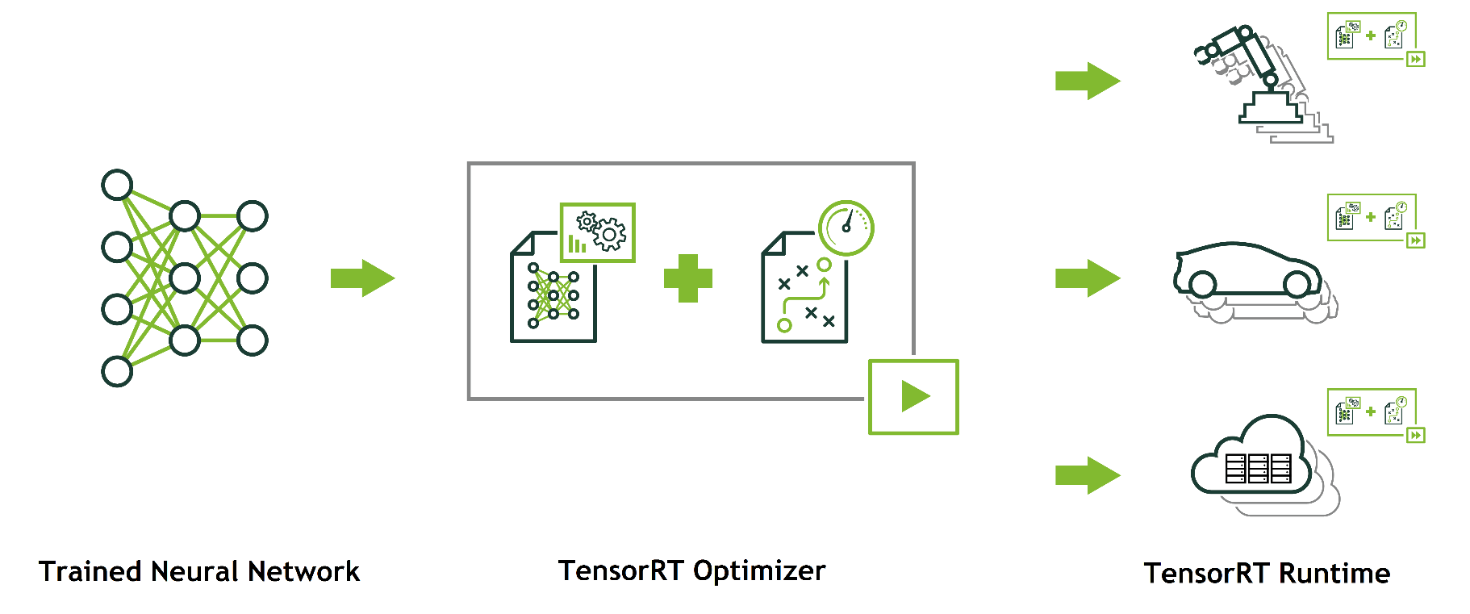
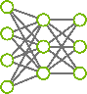
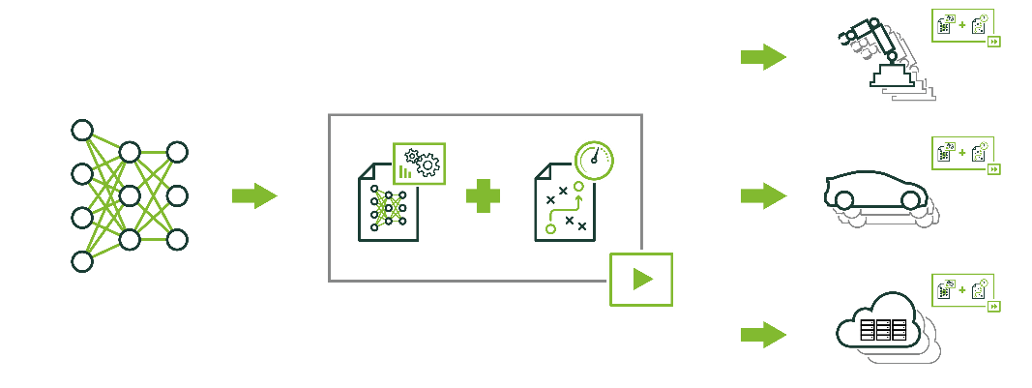



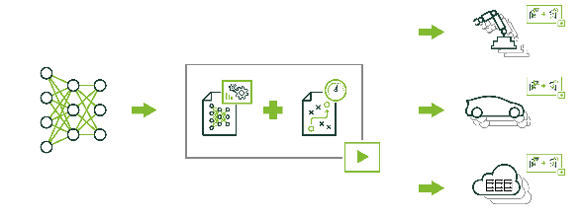


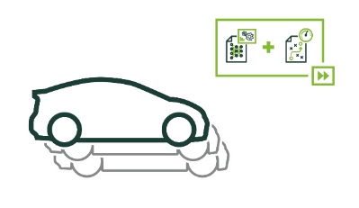

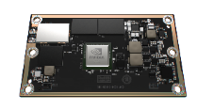
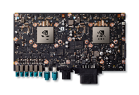
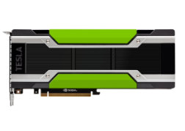
NVIDIA TensorRT
A Platform for High-Performance Deep Learning Inference
Optimize and deploy neural networks in production environments
Maximize throughput for latency-critical apps with optimizer and runtime
Deploy responsive and memory efficient apps with INT8 & FP16 optimizations
Accelerate every framework with TensorFlow integration and ONNX support
Run multiple models on a node with containerized inference server
Trained Neural Network
TensorRT Optimizer
TensorRT Runtime Engine
Embedded
Automotive
Data center
Jetson
Drive PX
Tesla

Slide 6




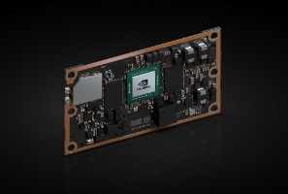
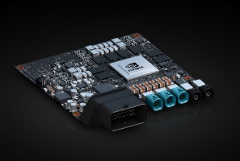


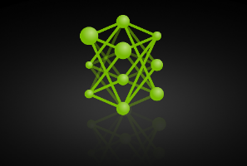

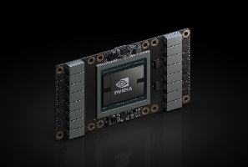

Nvidia Tensorrt
For Every Framework, Optimized for Each Target Platform
TensorRT
TESLA P4
JETSON TX2
DRIVE PX 2
NVIDIA DLA
TESLA V100

Slide 7
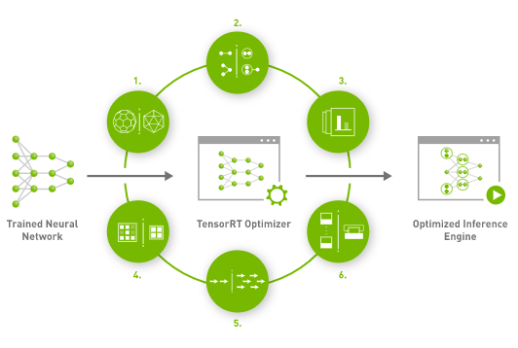
Tensorrt features
Layer & Tensor Fusion
Weight & Activation Precision Calibration
Kernel Auto-Tuning
Time Fusion
Dynamic Tensor Memory
Multi-Stream Execution

Slide 8
Concept: Graph transforms
Unoptimized Network
next input
concat
ReLU
ReLU
ReLU
ReLU
bias
bias
bias
bias
1x1 conv.
3x3 conv.
5x5 conv.
1x1 conv.
ReLU
ReLU
MaxPool
bias
bias
1x1 conv.
1x1 conv.
input
concat

Slide 9
Concept: Graph Transforms
Vertical Fusion
next input
concat
1x1 CBR
3x3 CBR
5x5 CBR
1x1 CBR
1x1 CBR
1x1 CBR
MaxPool
input
concat

Slide 10
Concept: Graph Transforms
Horizontal Fusion
next input
concat
3x3 CBR
5x5 CBR
1x1 CBR
1x1 CBR
MaxPool
input
concat

Slide 11
Layer & Tensor Fusion
Un-optimized network
TensorRT Optimized Network
next input
next input
concat
ReLU
ReLU
ReLU
ReLU
3x3 CBR
5x5 CBR
1x1 CBR
bias
bias
bias
bias
1x1 conv.
3x3 conv.
5x5 conv.
1x1 conv.
ReLU
ReLU
MaxPool
1x1 CBR
MaxPool
bias
bias
1x1 conv.
1x1 conv.
input
input
concat
Vertical Fusion
Horizonal Fusion
Layer Elimination

Slide 12
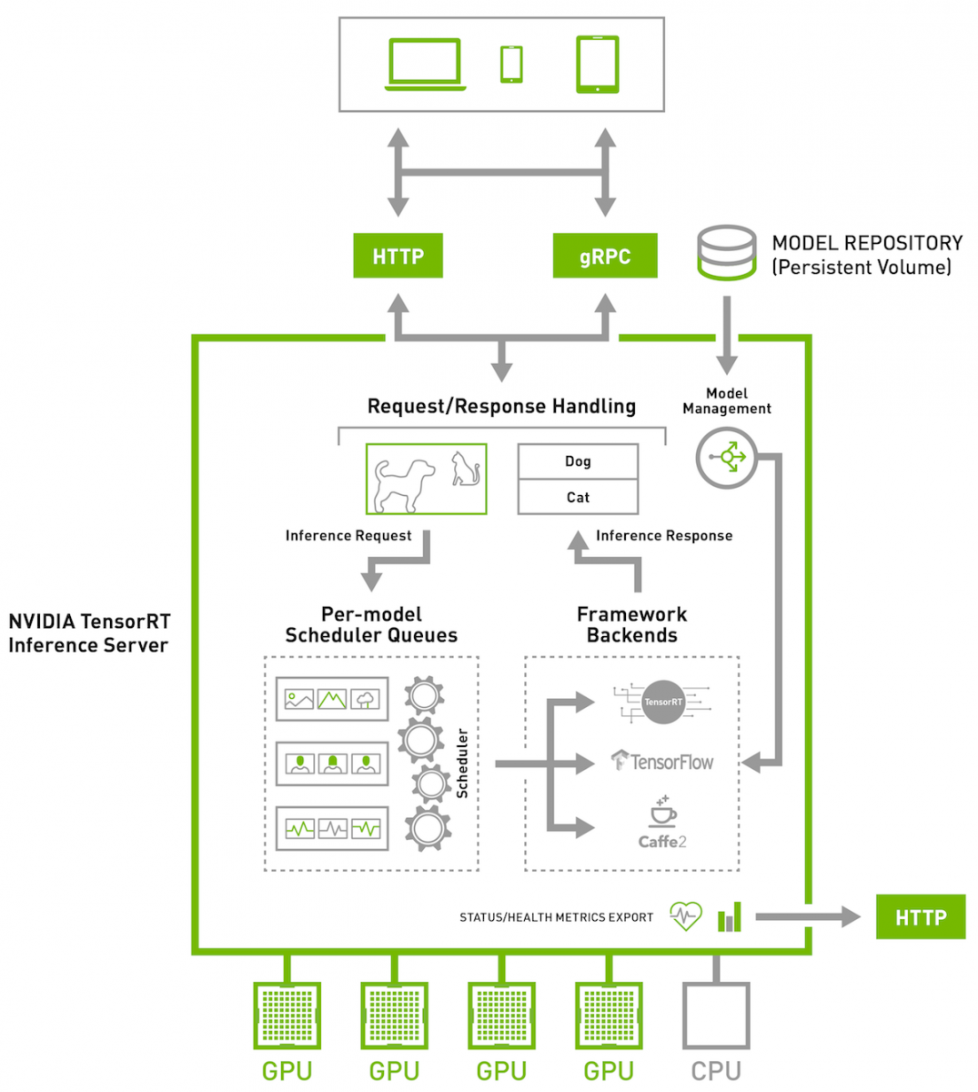
NVIDIA Triton Inference Server
Inference in multiple models for more GPUs
Supports all popular AI frameworks
Dynamically batches requests to increase throughput
Provides latency and health metrics
Auto scaling and load balancing

Slide 13
End of lab 3

Slide 14
Lab 1 Summary
Discuss Automatic Optical Inspection, PCBA process, current challenges of AOI machines on high false positives
Analyze, manipulate, and visualize real dataset from GPU production line
Examine labeling of data obtained from AOI machine and curating dataset further
Scope into short-term DL automation problem

Slide 15
Lab 2 summary
Apply transfer learning with ResNet-50 to train a custom classification model
Download pre-trained model/architecture from NGC
Apply augmentation technique to solve heavily imbalanced dataset
Fine-tune the model and setup evaluation metrics
Examine a confusion matrix and fine-tune results based on domain-expert tunable thresholding
Iterate “data curation – model training – error analysis” to further improve performance and reduce false positive rate

Slide 16
Lab 3 summary
Compile trained ResNet-50 model as TensorRT engine
Deploy TRT engine to Triton Inference Server
Send inference request to server
Compare the performance improvement using various inference configuration

